Slide 1


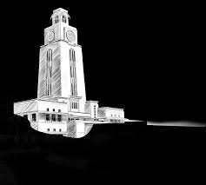

ITW 2025
Lecture
Bias Generators and Current Mirrors
Dr. Neeraj Mishra
High Performance Electronics Lab
Electrical & Electronics Eng. Dept.
Birla Institute of Technology & Science Pilani, Pilani Campus

Slide 2


-
Today’s Lecture
The need of current source
Problem of Biasing current source
Current Mirrors
Current Sources are everywhere
V_{DD}
V_{DD}
V_{DD}
V_{b}
M₂
$$R$$
V_{IN}
M₂
V_{out}
V_{out}
V_{out}
M₁
V_{b}
V_{IN}
M₁
V_{b}
M₁
V_{IN}
Problem of Biasing Current Sources
I_{D}
$$ID= \frac{1}{2} μ_{n}Cox\frac{W}{L} {\left[V\text{b}\text{−}VTHn\right]}^{2}$$
M₁
V_{b}

Slide 3


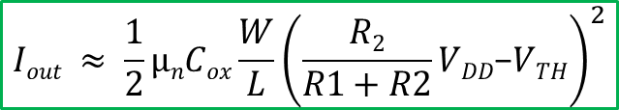
How to generate
V_{b}
V_{DD}
Analog circuits require bias currents that are stable over process, voltage, and temperature for proper operation
The most popular circuit used to generate a stable reference is a “Bandgap Reference”
A Bandgap Reference Circuit generates a voltage that is very stable over temperature
  This stable voltage can be used to generate a reference current stable over process, voltage, and temperature.
$$R1$$
I_{out}
$$Iout ≈ \frac{1}{2}µnCox\frac{W}{L}{\left(\frac{R2}{R1+R2}VDD\text{−}VTH\right)}^{2}$$
M₁
$$R2$$
V_{b}
Solution.
Create a stable “precise” current reference and “copy” the currents
Golden Reference
Reference Circuits
Current
Source
Current
Sink

Slide 4

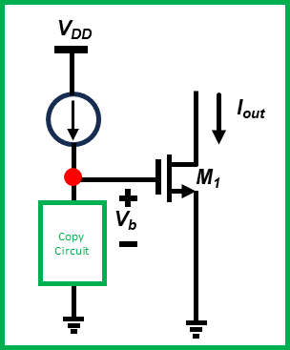
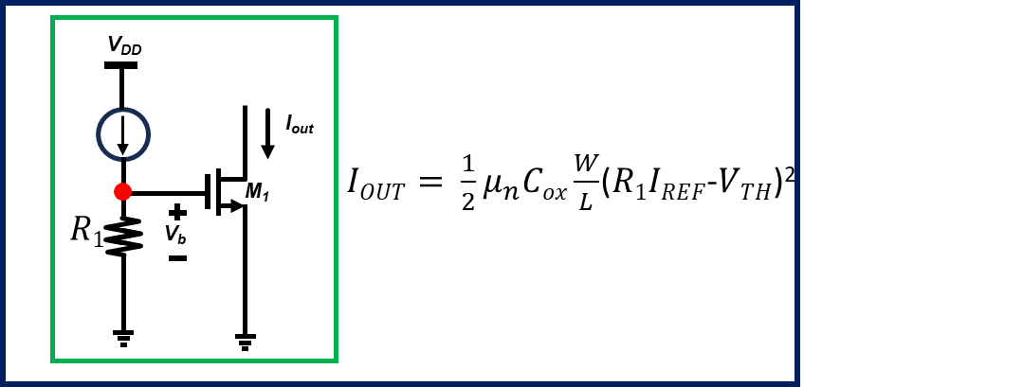



Current Mirrors (Basic Concept)
We build one “V_{golden}” current source using bandgap circuits.
Then we “copy” (clone) this current source to build many others.
Observation
Diode MOS characteristics with voltage source
Diode MOS characteristics with current source
I₁
V₁
v
I₁
I_{out}
I_{out}
V₁
M₁
I₁
V₁
M₁
V_{TH}
V_{TH}
V₁
I₁
If M₁is on and it is in saturation
V$1= \sqrt{\frac{2I1}{μ_{n}Cox\frac{W}{L}}}+VTH$
$I1 = \frac{1}{2}μ_{n}Cox\frac{W}{L}$($V1$-$VTH$)²
($V1>VTH$)

Slide 5
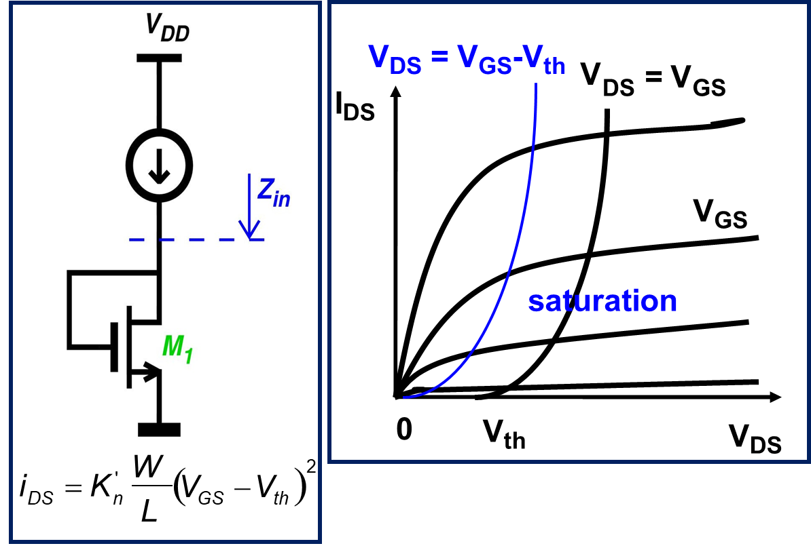




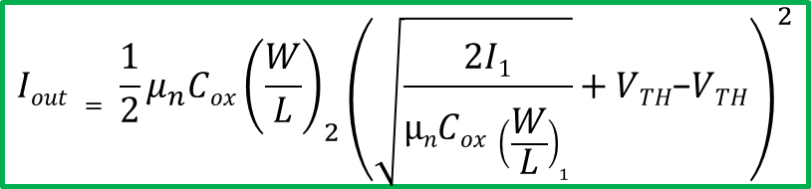






Diode Connected MOS Transistors
Ideal Current Mirror
$Iout$v
V_{DD}
$$Iin$$
$$Iin$$
$$Iout$$
$$Zin$$
$$Iout$$
$$Zout$$
$$Zin→Low (ideally 0)$$
$$Zout→High (ideally ∞)$$
Basics of current mirror
v
I_{out}
$Iout = \frac{1}{2}μ_{n}Cox{\left(\frac{W}{L}\right)}_{2}$($V1$-$VTH$)²
M₂
$$Iout = \frac{1}{2}μ_{n}Cox{\left(\frac{W}{L}\right)}_{2}{\left(\sqrt{\frac{2I1}{µnCox {\left(\frac{W}{L}\right)}_{1}}}+VTH\text{−}VTH\right)}^{2}$$
$$Iout = \left(\frac{{\left(\frac{W}{L}\right)}_{2}}{{\left(\frac{W}{L}\right)}_{1}}\right)I1$$
I₁
V₁
M₁

Slide 6




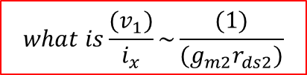



Deriving Impedance (DC only)
Looking into source
M₁
M₁
i_{d}=g_{m}v_{x}
$Z_{in}=\frac{v_{x}}{i_{x}}$ = $\frac{v_{x}}{i_{d}}$ = $\frac{1}{g_{m}}$
?
Z_{in}
V_{dc}
V_{x}
i_{x}
Z_{in} =?
v_{x}
Z_{in} =?
D
$$Z_{in}=r_{ds}$$
Z_{in} =?
M₁
M₁
V_{gs} = 0
Looking into drain
g_{m} V_{gs} = 0
Z_{in} = r_{ds}
V_{dc}
$$v_{1}=(i_{x}r_{ds1})$$
$$i_{x}=\left({−g}_{m2}\right)v_{1}+\frac{{(v_{x}−v}_{1})}{r_{ds1}}$$
Cascode
Z_{in} =?
i_{x}
V₁
g_{m2} V₁
r_{ds2}
i_{x}
$i_{x}=\left({−g}_{m2}\right)(i_{x}r_{ds1})+\frac{(v_{x})}{r_{ds1}}$- $\frac{{(i}_{x}r_{ds1})}{r_{ds2}}$
M₂
v_{x}
v_{x}
i_{x}
$$i_{x}(1+g_{m2}r_{ds1}+\frac{r_{ds1}}{r_{ds2}})=\frac{(v_{x})}{r_{ds2}}$$
$$v_{1}$$
V_{dc2}
r_{ds1}
M₁
${\frac{(v_{x})}{i_{x}}=Z}_{in}=\left(r_{ds1}+r_{ds2}+\left(g_{m2}r_{ds2}\right)r_{ds1}\right)\sim$ ($g_{m2}r_{ds2}r_{ds1}$)
$$what is\frac{(v_{1})}{i_{x}}\sim \frac{(1)}{(g_{m2}r_{ds2})}$$
V_{dc1}

Slide 7
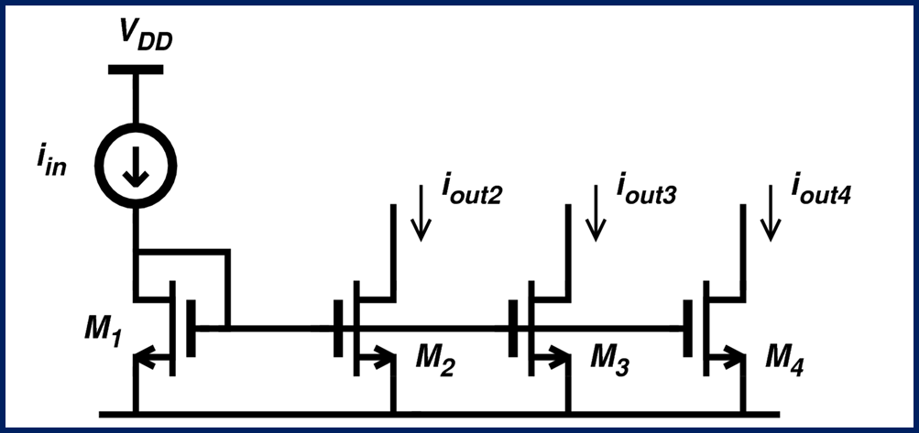










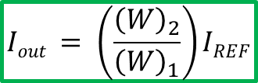
$Iout$v
PMOS Current Mirror
V_{DD}
$$Zin=\frac{(1)}{(g_{m1})}$$
M₁
$Zout$=$r_{ds2}$
M₂
$$Iout$$
$$Iout = \left(\frac{{\left(\frac{W}{L}\right)}_{2}}{{\left(\frac{W}{L}\right)}_{1}}\right)IREF$$
$$IREF$$
NMOS Current Mirror
$if L1$=$L2$
V_{DD}
$$Iout = \left(\frac{{\left(W\right)}_{2}}{{\left(W\right)}_{1}}\right)IREF$$
$$IREF$$
$$Iout$$
$$Zin=\frac{(1)}{(g_{m1})}$$
M₁
M₂
$Zout$=$r_{ds2}$

Slide 8
Gate-source matching principle
A. If the gate-source voltages of two or more transistors of same type are equal and the transistors are matched and operating in the saturation region, then the drain-source currents are related by the (W/L) ratios of the individual transistors. The gate-source voltages may be directly connected or implied
8
Notes:
10/31/2025
8

Slide 9
Drain-source matching principle
B. If the drain-source currents of two or more transistors are equal and the Transistors are matched and operating in the saturation region, then the Gate-source voltages are related by the (W/L) ratios ignoring bulk effects
or
The above relationships are exact if the drain-source voltages of both
transistors are equal
9
Notes:
10/31/2025
9

Slide 10
Effects of mismatch
15% if the errors are correlated!
10
Notes:
10/31/2025
10

Slide 11
Current sinks (NMOS) and sources (PMOS)
“Sink”
Circuit
r_{out} is a measure of the “flatness” of the current sink/source and is independent of voltage, we desire r_{out} to be high.
V_{MIN} is the minimum across the sink/source for which the current is no longer constant, we desire V_{MIN} to be low.
11
Notes:
10/31/2025
11

Slide 12
Current sinks (NMOS) and sources (PMOS)
“Source”
Circuit
r_{out} is a measure of the “flatness” of the current sink/source and is
independent of voltage, we desire r_{out} to be high
V_{MIN} is the minimum across the sink/source for which the current
is no longer constant, we desire V_{MIN} to be low
12
Notes:
10/31/2025
12

Slide 13
Dependency on gate-source
Provide
current
Enhance
channel
= Part to enhance channel + part to cause current flow
V_{MIN} can be reduced by using large values of (W/L)
13
Notes:
10/31/2025
13

Slide 14
Increasing the output impedance
Circuit
Intuitive:
i_{out} increases→ (b) v_{S} increases → (c) v_{GS}=V_{GG}-v_{S} decreases
→ (d) i_{out} decreases
Feedback can be used to obtain answer quickly
14
Notes:
10/31/2025
14

Slide 15
Increasing the output impedance
Circuit
Used for analysis only
The same derivation without using feedback (i.e., basic small signal)
has been shown before
Hence,
the output resistance of a cascode circuit = R X (common source
intrinsic voltage gain of the cascode transistor)
15
Notes:
10/31/2025
15

Slide 16
Increasing the output impedance further
Circuit
Same answer as before, except the degeneration
resistance R has been replaced by the output resistance
of NMOS
Improvements of cascode structures does not come
for free, note the additional drain-source voltage
is added to keep M_{N3} In saturation
16
Notes:
10/31/2025
16

Slide 17
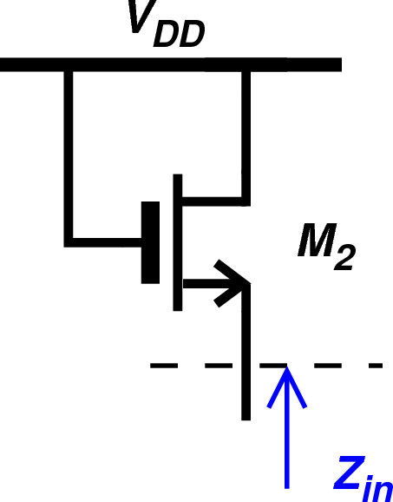
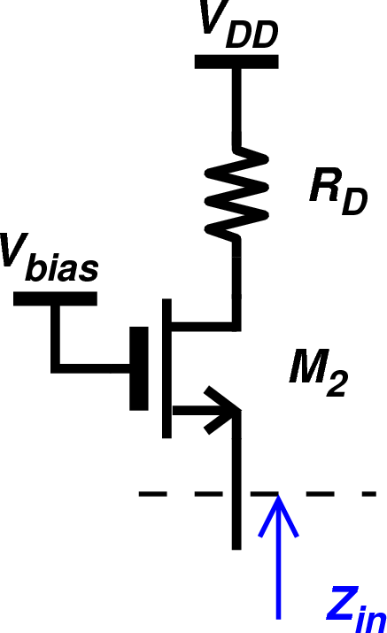
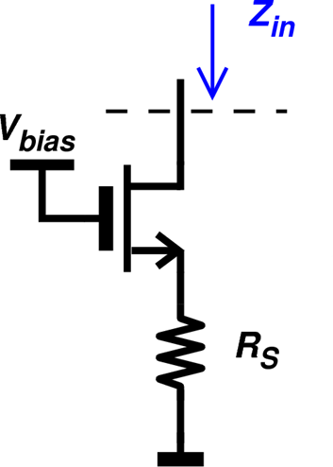
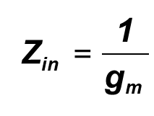
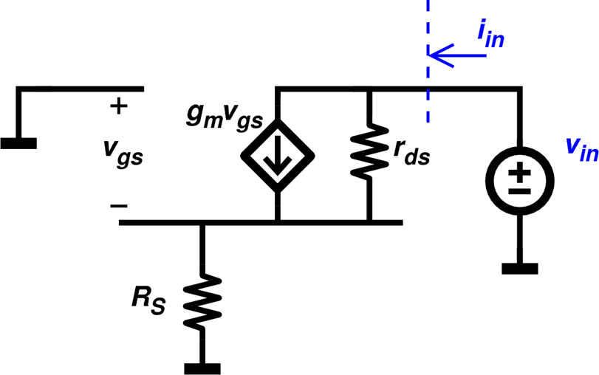
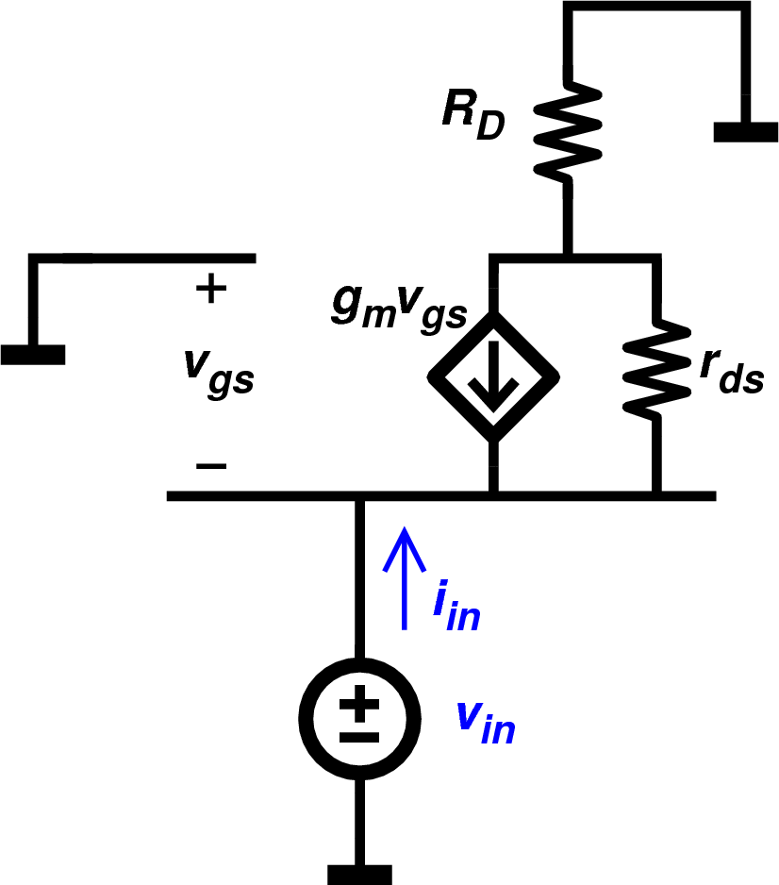
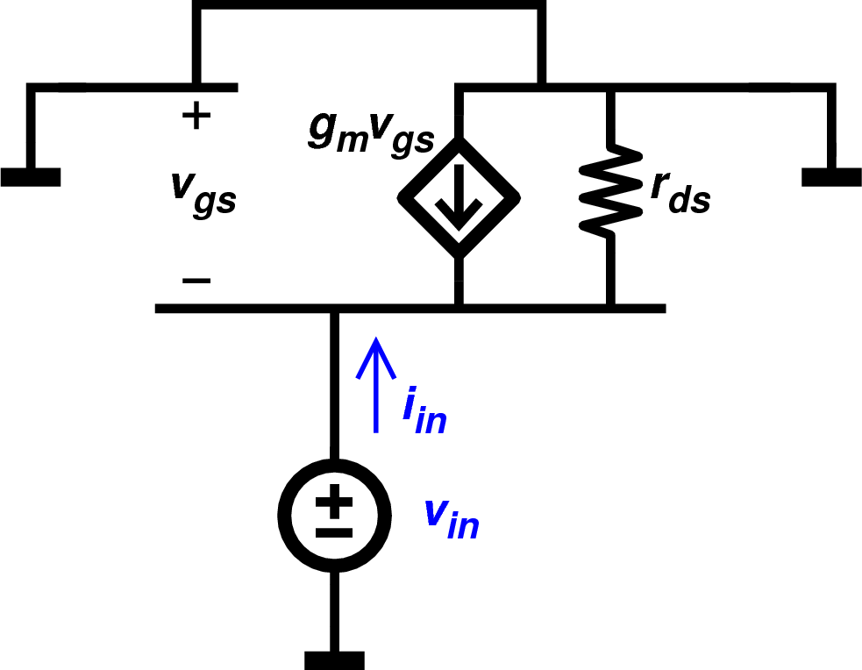
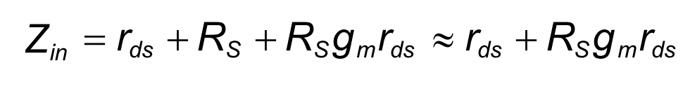
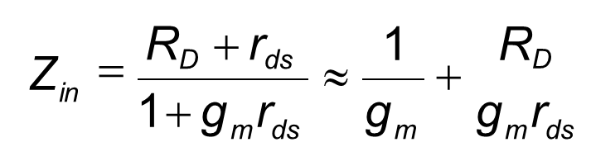
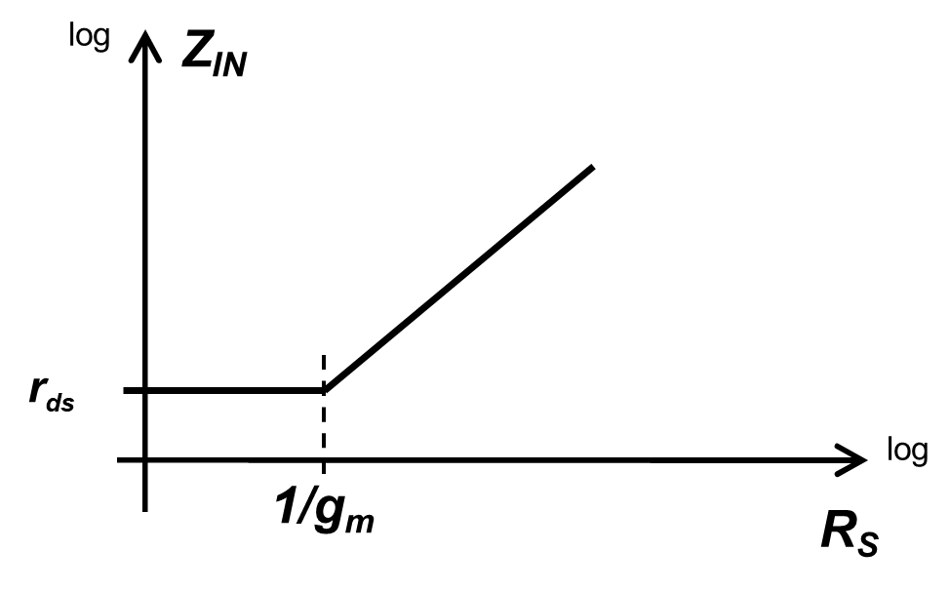
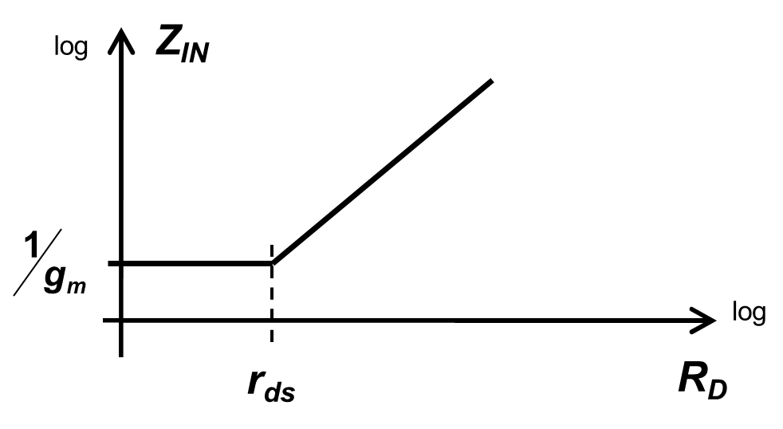
Looking Into Node
i_{in} = −g_{m}v_{gs}
^{v}gs
r
^{v}in
= −v_{gs}
ds
₌ ^{v}in
1
Z
≈
in
i g
in
m

Slide 18
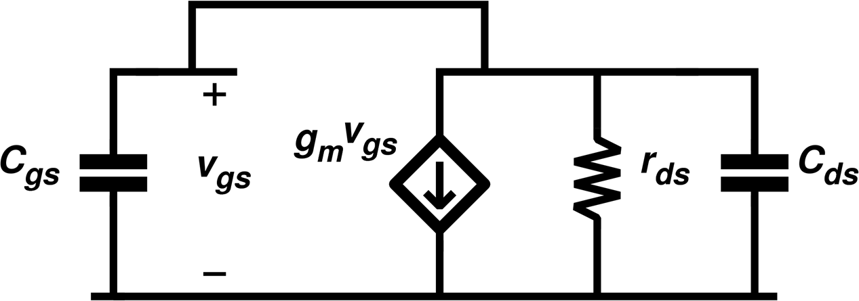
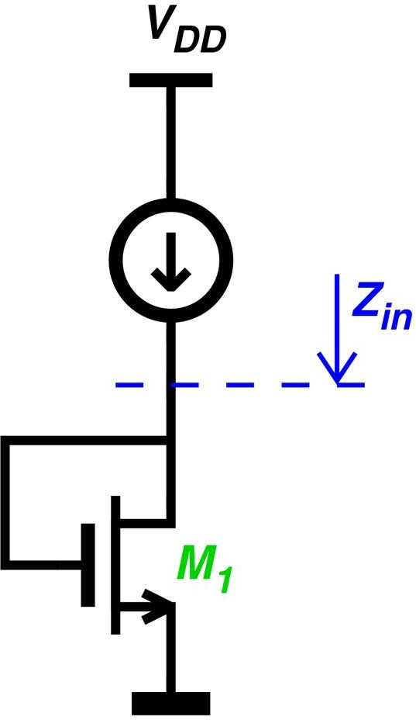
Diode-connected MOS transistor
^{V}DS ^{= V}GS^{-V}th _{V}
= V
DS
GS
^{I}DS
1
1
^{V}GS
saturation
Z = ¹ || r =
≈
in
g
ds
g + g g
m
m
ds
m
low impedance!
g
f
f ≈
m
≈
T
2Π(C + C ) 2
0
^{V}th
^{V}DS
3dB
W
gs
ds
i = K '
L
(V −V )
2
DS
n
GS
th
HIGH !

Slide 19
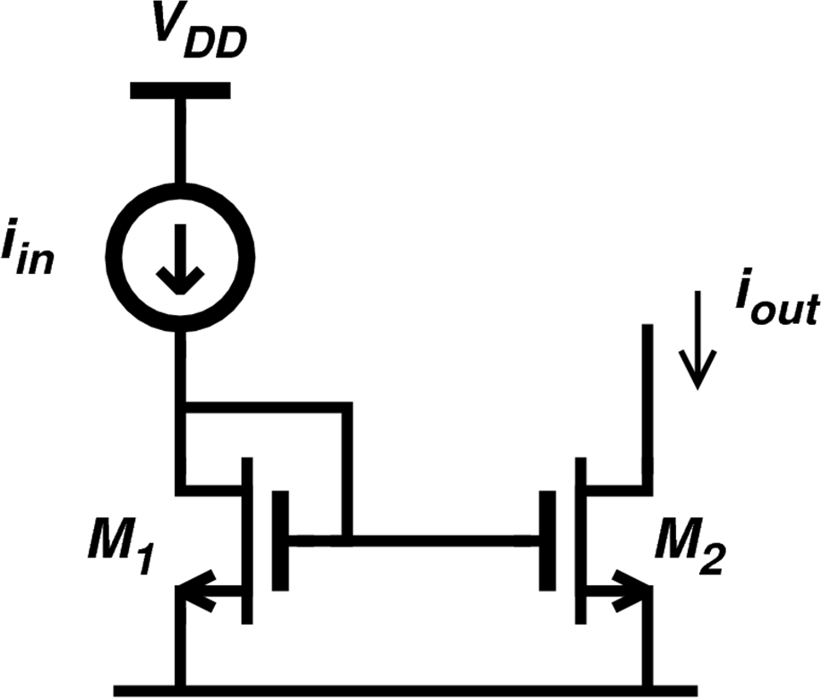
Current mirror
^{i}_{DS}
^{Δi}out
1
R =
in
g
^{v}_{GS}
m1
^{C}in
= C_{gs1} + C_{ds1} + C_{gs 2}
≈ (2 + B)C_{gs1}
1 : B
^{v}_{DS1} ^{= v}_{GS1} ^{v}_{DS2} ^{v}_{DS}
^{g}m1
2π (2 + B)C
f_{T}
^{v}DS2 ^{- v}DS1
=
f =
=
^{Δi}out
p,in
2 + B
^{i}out ^{= B i}in
V_{E}L₂
gs1
^{i}out

Slide 20
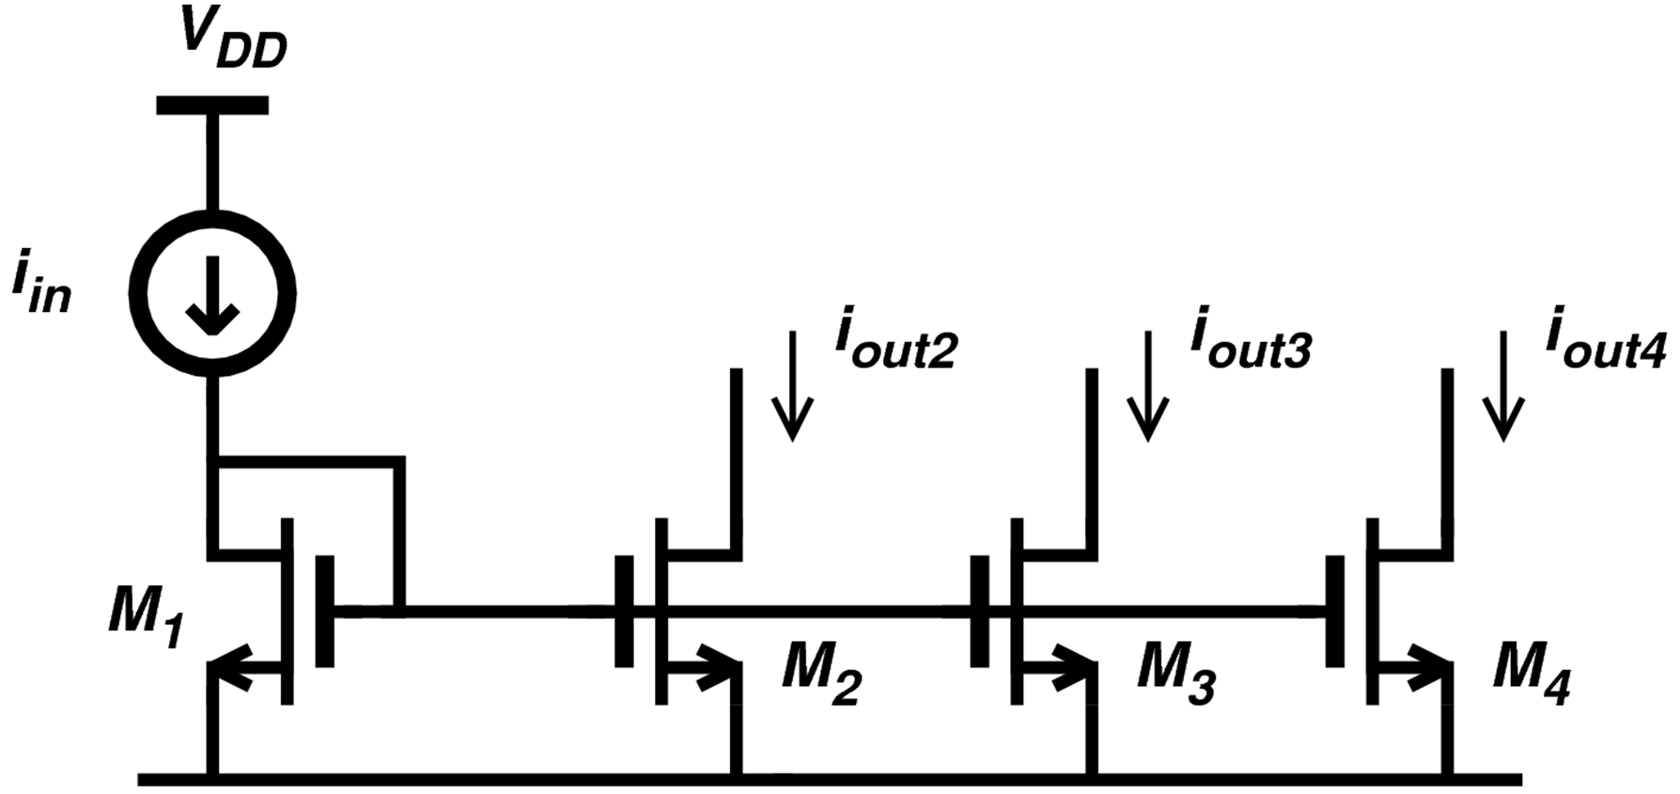
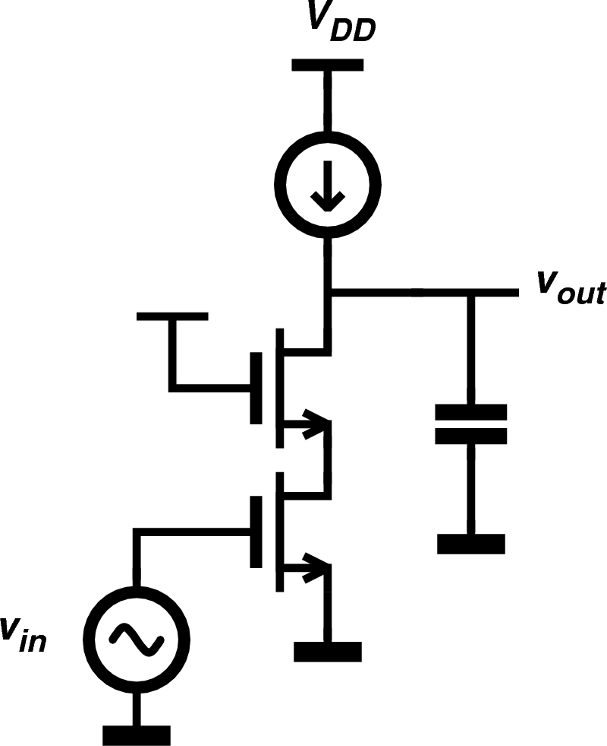
^{R}out ^{≈ r}o1^{(g}m2^{r}o2 ⁾
Current mirror/Cascode Design
₌ ^{v}out
= −(g r )(g r )
1
A
^{i}out ^{= g}m1^{v}in
^{v}out ^{= R}out ^{i}out
v 0
v
m1 o1
m2 o 2
in
M2
BW =
2πR_{out}C_{L}
M1
GBW =
^{g}m1
2πC_{L}

Slide 21
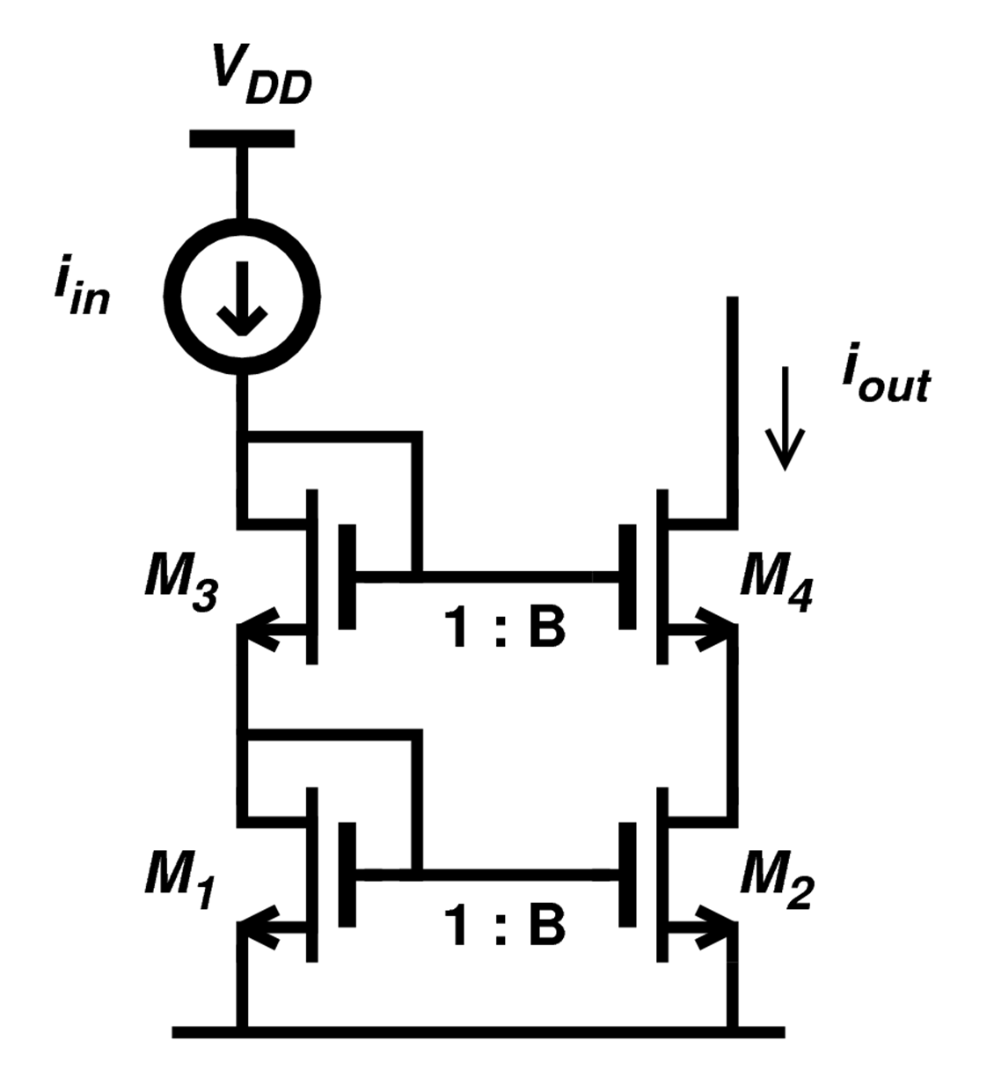
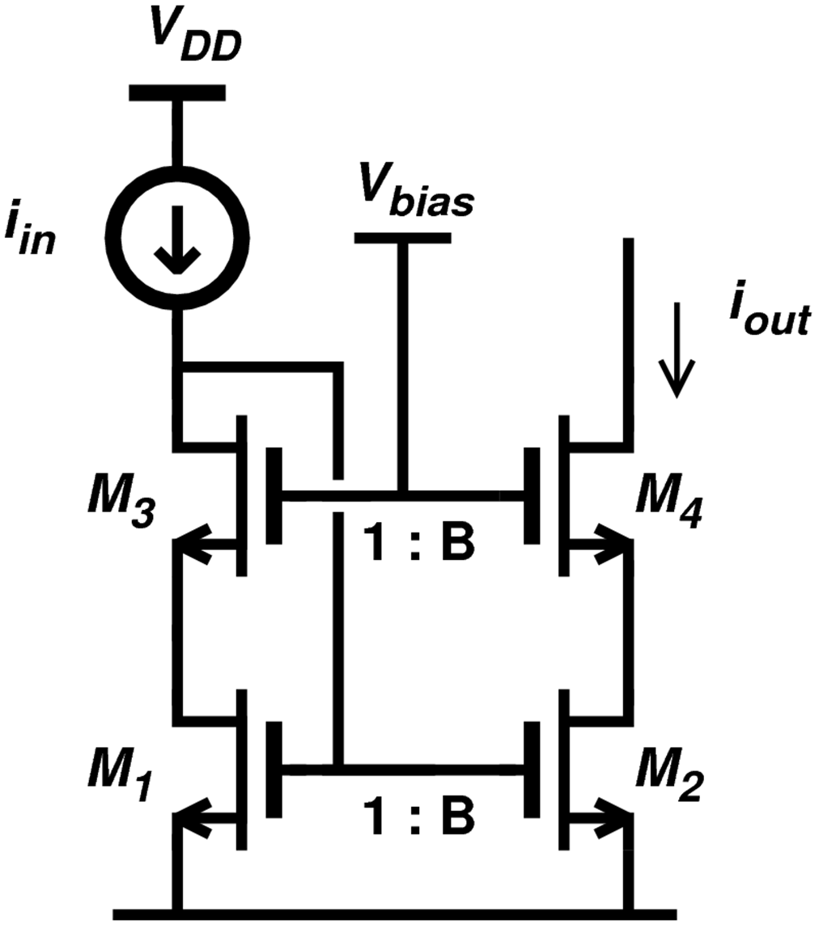
Current mirror using Cascode Design
V_{DS1} = V_{DS2} ➔ lower error in current ratio
V_{in,min} = V_{GS1}+V_{GS4} = high ! V_{out, min} = V_{DS2}+ V_{DS4}
= V_{GS1}+ V_{DS4} = high!
Vout,min = VDS2+VDS4 = low!
Vin,min = VGS1 = low!

